Slide 1
VPN Technology
Portions of this PPT draw from PPT authored by Professor Dijiang Huang at
Arizona State University

Slide 2
Common VPN Protocols
PPTP (Point-to-Point Tunneling Protocol)
L2F (Layer-2 Forwarding Protocol)
L2TP (Layer 2 Tunneling Protocols)
PPP (Point-to-Point Protocol)
VLAN (Virtual Local Area Networks)
VXLAN (Virtual eXtensible LAN)
MPLS (MultiProtocol Label Switching)
GRE (Generic Routing Encapsulation)
SSL (Secure Socket Layer)
Ipsec (IP security)

Slide 3
Terminology: VPN & Tunneling
Virtual Private Network is a private network that uses a public network (usually the Internet) to connect remote sites or users together. Instead of using a dedicated connection such as leased line, a VPN uses “virtual” connections routed through the internet.
Tunneling is the transmission of data intended for use only within a private, usually corporate network through a public network in such a way that the routing nodes in the public network are unaware that the transmission is part of a private network.
In other words, these two terms can be interchangeable depending on where to use them.

Slide 4
VPN Benefits
Enable communications between corporate
private LANs over
Public networks
Leased lines
Wireless links
It is overlay network
Corporate resources (e-mail, servers, printers) can be accessed securely by users having granted access rights from outside (home, while travelling, etc.)
Software Defined Networking (SDN) has been widely using tunneling and VPN approaches.

Slide 5
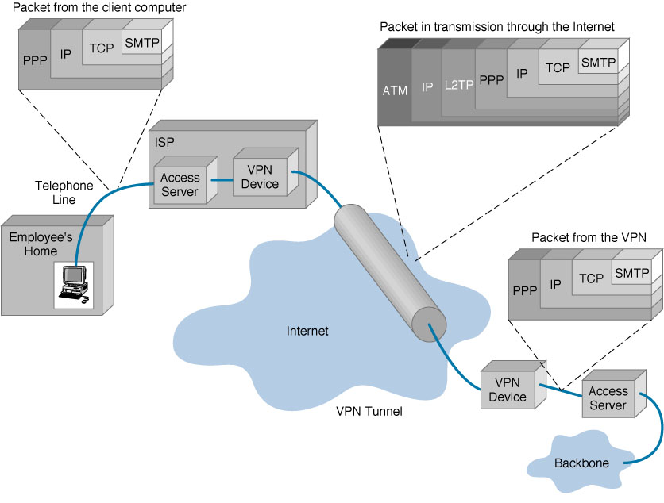
VPN Encapsulation of Packets Example
Notes:
ATM provides functionality that is similar to both circuit switching and packet switching networks: ATM uses asynchronous time-division multiplexing,^{[4][5]} and encodes data into small, fixed-sized packets (ISO-OSI frames) called cells. This differs from approaches such as the Internet Protocol or Ethernet that use variable sized packets and frames. ATM uses a connection-oriented model in which a virtual circuit must be established between two endpoints before the actual data exchange begins.^{[5]} These virtual circuits may be “permanent”, i.e. dedicated connections that are usually preconfigured by the service provider, or “switched”, i.e. set up on a per-call basis using signalling and disconnected when the call is terminated.
Layer Two Tunneling Protocol (L2TP) is an extension of the Point-to-Point Tunneling Protocol (PPTP) used by an Internet service provider (ISP) to enable the operation of a virtual private network (VPN) over the Internet.
Point-to-Point Protocol (PPP) is a data link protocol used to establish a direct connection between two nodes. It can provide connection authentication, transmission encryption (using ECP, RFC 1968), and compression.

Slide 6
VPN Topology: Types of VPNs
Types of VPNs
Remote access VPN
Intranet VPN
Extranet VPN
Three Types of Tunnels
Gateway to Gateway
Host to Gateway
Host to Host

Slide 7
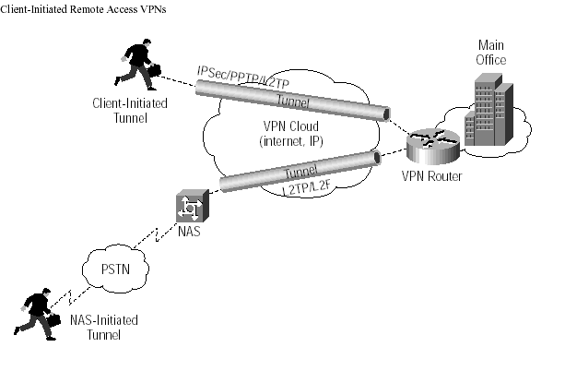
VPN Topology: Remote Access VPN
PSTN: Public Switch Telephone Networks
Notes:
A network access server (NAS) is a single point of access to a remote resource. A NAS concentrates dial-in and dial-out user communications.

Slide 8
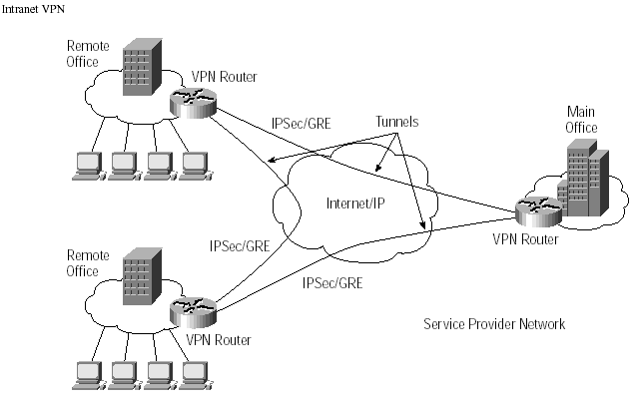
VPN Topology: Intranet VPN

Slide 9
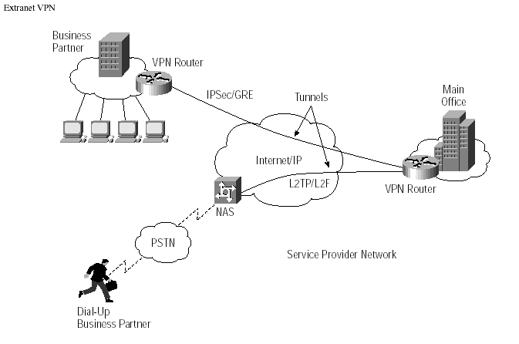
VPN Topology: Extranet VPN

Slide 10
L2TP
L2TP = L2F + PPTP
Combines the best features of L2F and PPTP
Allows PPP frames to be sent over non-IP (Frame relay, ATM) networks also (PPTP works on IP only)
Allows multiple (different QoS) tunnels between the same end-points. Better header compression. Supports flow control

Slide 11
Layer 2 Tunneling Protocol
An example of network layer VPN: use IP packets to encapsulate Layer 2 frames
Previous RFC (v2)
RFC2661 Layer Two Tunneling Protocol L2TP W. Townsley, A. Valencia, A. Rubens, G. Pall, G. Zorn, B. Palter. August 1999 (PROPOSED STANDARD)
A standard method for tunneling Point-to-Point Protocol (PPP) [RFC1661] sessions
Note: L2TP has since been adopted for tunneling a number of other L2 protocols (e.g., Ethernet, Frame Relay, etc). → L2TPv3 [RFC3931]

Slide 12
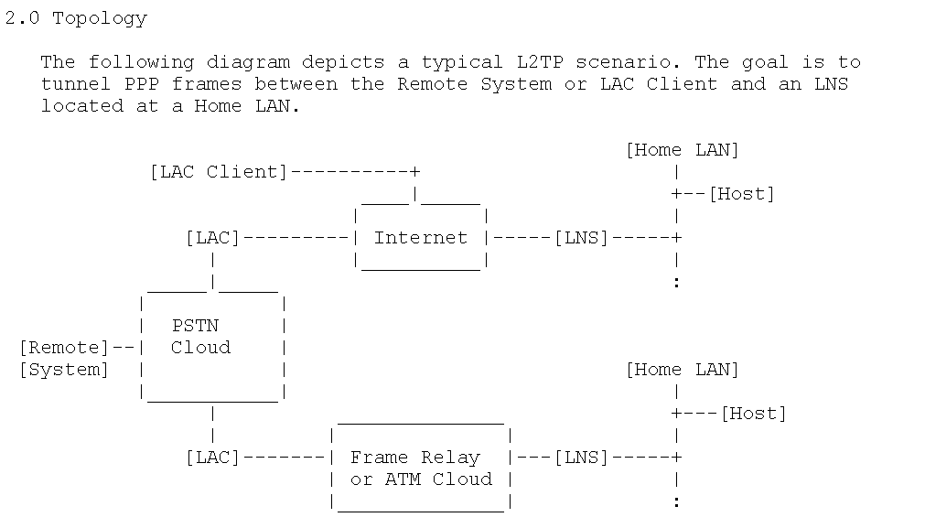
Layer 2 Tunneling Protocol (cont.)
A typical L2TP scenario (from RFC2661)
LAC (L2TP Access Concentrator) and the LNS (L2TP Network Server)

Slide 13
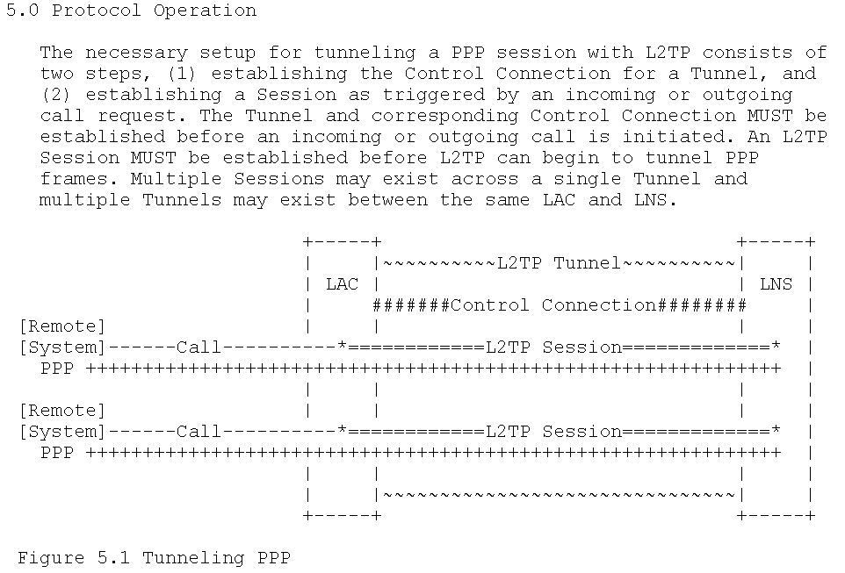
L2TP Tunnel Setup (from RFC2661)

Slide 14
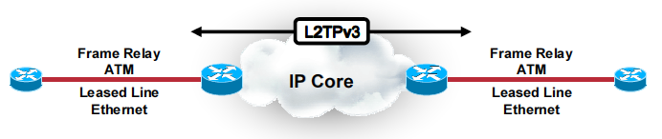
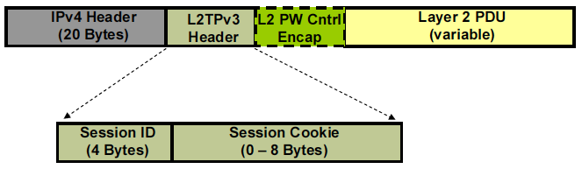
L2TPv3 Tunneling example

Slide 15
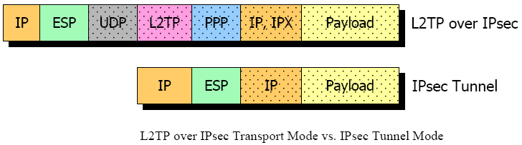
L2TP-over-IPsec

Slide 16
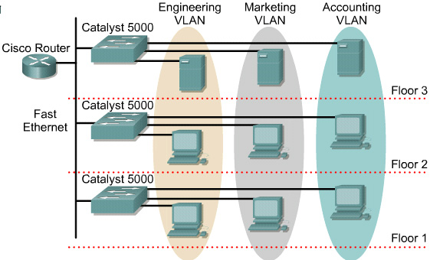
VLAN introduction
VLANs function by logically segmenting the network into different broadcast domains so that packets are only switched between ports that are designated for the same VLAN.
Routers in VLAN topologies provide broadcast filtering, security, and traffic flow management.

Slide 17
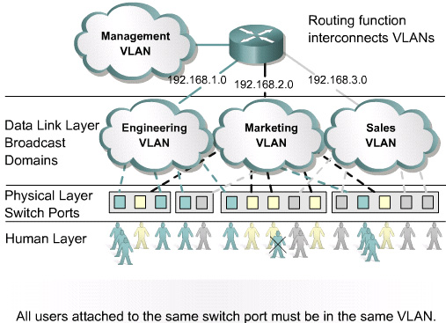
Benefits of VLANs
The key benefit of VLANs is that they permit the network administrator to organize the LAN logically instead of physically.

Slide 18
VLAN types
There are three basic VLAN memberships for determining and controlling how a packet gets assigned:
Port-based VLANs
MAC address based
Protocol based VLANs
The frame headers are encapsulated or modified to reflect a VLAN ID before the frame is sent over the link between switches.
Before forwarding to the destination device, the frame header is changed back to the original format.

Slide 19
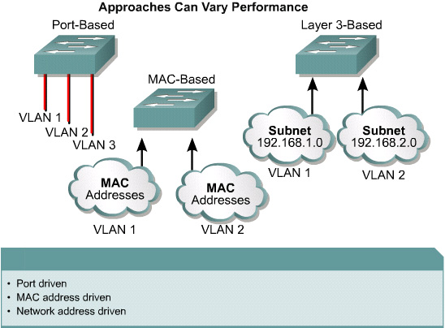
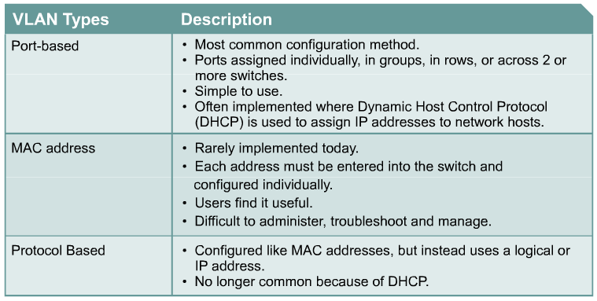
VLAN types
Port-based VLANs
MAC address based VLANs
Protocol based VLANs

Slide 20
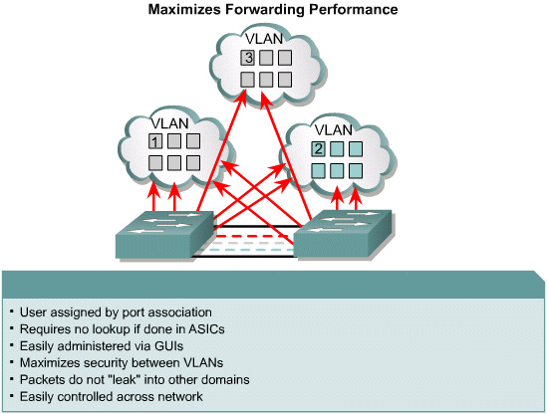
Membership by Port

Slide 21
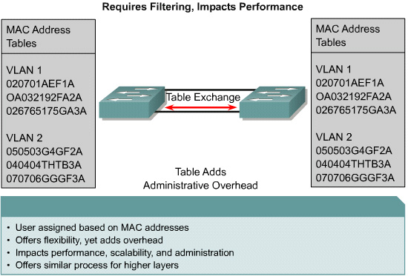
Membership by MAC-Addresses

Slide 22
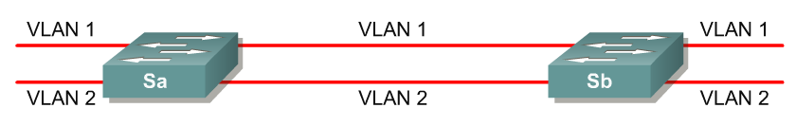
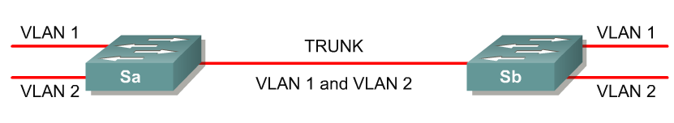
VLAN Tagging
.
No VLAN Tagging
VLAN Tagging
VLAN Tagging is used when a single link needs to carry traffic for more than one VLAN.

Slide 23
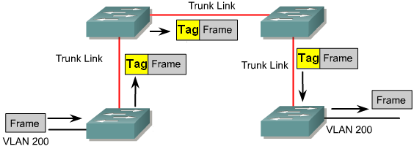
Tag to identify VLAN
Tag is added to the frame when it goes on to the trunk
Tag is removed when it leaves the trunk

Slide 24
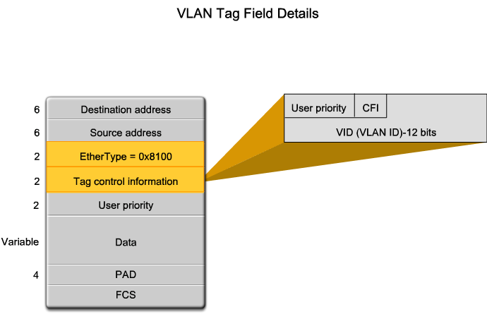
VLAN Trunk - 802.1Q Frame tagging

Slide 25
Frame tagging IEEE 802.1Q
Normal frame
Dest Add
Source Add
Type/Len
Data
FCS
Dest Add
Source Add
Tag
Type/Len
Data
FCS
Add 4-byte tag, recalculate FCS
Tag protocol ID 0x8100
Priority
CFI for token ring
VLAN ID 1 - 4096
16bits
3bits
1bit
12bits
Frame Check Sequence (FCS)

Slide 26
VLAN 802.1ad (QinQ)
Provider Bridge (IEEE 802.1ad)
Two VLAN tags and hence called Q-in-Q
Ethernet frame without VLAN Tag
FCS
Data
Type/ Length
Source address
Destination address
Ethernet frame with 32 bit VLAN Tag (802.1Q)
FCS
Data
Type/ Length
Tag
Source address
Destination address
Ethernet frame with 32 bit VLAN Tag (802.1ad)
FCS
Data
Type/ Length
C-Tag
S-Tag
Source address
Destination address

Slide 27
VXLAN: VLANs for data centers
Prior IEEE 802.1Q standard: 12 bits = 4094 VLANs
What if each tenant in datacenter wants isolated subnet?
Quickly run out of VLAN ids
VLANs need to all be in same Ethernet SP, doesn’t scale
Enter VXLAN:
24 bit VLAN ids
Bridge multiple layer-3 subnets, using MAC-in-IP tunneling
Give impressive of single large layer-2 subnet per tenant
Enable establishing VLAN through Internet
Backed by VMWare + Cisco
http://tools.ietf.org/html/draft-mahalingam-dutt-dcops-vxlan-00

Slide 28
What is VXLAN?
At its core, VXLAN is simply a MAC-in-UDP encapsulation (in other words, encapsulation of an Ethernet L2 Frame in IP) scheme enabling the creation of virtualized L2 subnets that can span physical L3 IP networks.
VXLAN enables the connection between two or more L3 networks and makes it appear like they share the same L2 subnet.
It allows virtual machines to operate in separate networks while operating as if they were attached to the same L2 subnet.

Slide 29
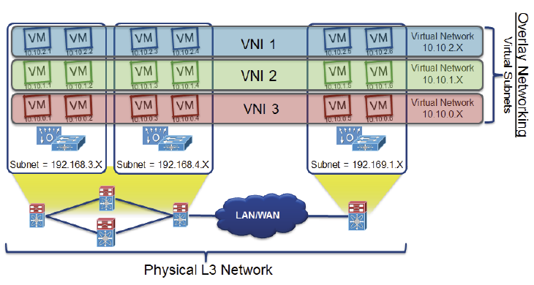
VXLAN Ethernet Frame Encapsulation

Slide 30
Generic Routing Encapsulation (GRE)
Provides low overhead tunneling (often between two private networks)
Does not provide encryption
Used to encapsulate an arbitrary layer protocol over another arbitrary layer protocol:
delivery header + GRE header + payload packet
Mostly IPv4 is the delivery mechanism for GRE with any arbitrary protocol nested inside
e.g., IP protocol type 47: GRE packets using IPv4 headers
RFCs:
RFC1701 Generic Routing Encapsulation (GRE) S. Hanks, T. Li, D. Farinacci, P. Traina, October 1994 (INFORMATIONAL)
RFC2784 Generic Routing Encapsulation (GRE) D. Farinacci, T. Li, S. Hanks, D. Meyer, P. Traina, March 2000 (PROPOSED STANDARD)
RFC2890 Key and Sequence Number Extensions to GRE G. Dommety, September 2000 (PROPOSED STANDARD)
Notes:
“TUNNELING protocols”:
A network protocol that encapsulates packets at a peer level or below. It is used to transport multiple protocols over a common network as well as provide the vehicle for encrypted virtual private networks (VPNs). It is said to "tunnel" because it "pushes through" packets of different types. It is also called an "encapsulation protocol," which is confusing, because all protocols encapsulate. In a regular protocol, the lower layer protocol encapsulates the higher level protocol. For example, the network layer protocol (layer 3) encapsulates a transport layer packet (layer 4). In contrast, a tunneling protocol encapsulates a packet of the same or lower protocol. For example, GRE could encapsulate a layer 3 IPX packet within a layer 3 IP packet. VPLS encapsulates a layer 2 Ethernet frame within a layer 3 IP packet. See IP tunneling and L2TP.

Slide 31
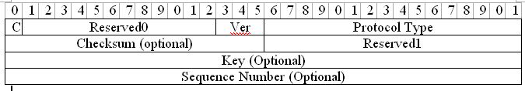
Generic Routing Encapsulation
GRE Header (based on RFC1701, deprecated): Figure 11-2
GRE Header (based on RFC 2784 & 2890): Figure 11-4
C = 1, checksum present
Checksum: to ensure the integrity of the GRE header and the payload packet; contains a checksum of the GRE header and the payload packet
Key:
contains a number to prevent misconfiguration of packets;
may be used to identify individual traffic flow within a tunnel
Not the same as a cryptographic key

Slide 32
Generic Routing Encapsulation Example
original
header
original data
outer header
GRE header
original header
original data
new header
new data
ver.
IHL
TOS
length
IP identification
flags
fragment offset
TTL
GRE
IP checksum
IP address of HA
Care-of address COA
Example: GRE for Mobile IP
C
R
K
S
s
rec.
rsv.
ver.
protocol
checksum (optional)
offset (optional)
key (optional)
sequence number (optional)
routing (optional)
ver.
IHL
TOS
length
IP identification
flags
fragment offset
TTL
lay. 4 prot.
IP checksum
IP address of CN
IP address of MN
TCP/UDP/ ... payload

Slide 33
Generic Routing Encapsulation
Summary:
GRE mainly perform ‘tunneling’.
Does not provide a means to securely encrypt its payload
Often relies on application layer to provide encryption
May be used together with a network layer encryption (such as IPsec)
Example 1: use GRE to encapsulate non-IP traffic and then encrypt the GRE packet using IPsec
Example 2: use GRE to encapsulate multicast traffic, and then encrypt the GRE packet using IPsec
Question: Why not simply use IPsec?

